Slide 1
Lab Notebook:
METC-143 – Materials and Processes
David Rogers
METC-143 Spring 2014
Ivy Tech Community College Northeast

Slide 2
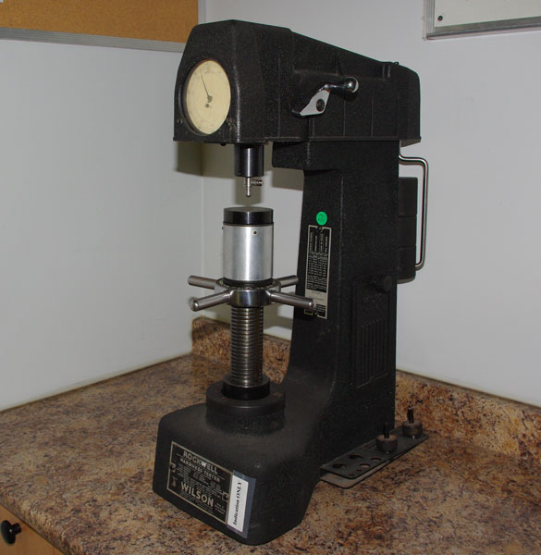
Lab 1: Rockwell Hardness Presentation
Overview:
In this lab Michael Roeback and myself did a short presentation on the Wilson Rockwell Hardness machine, including a little history and how it works.
Company Founded in 1920
Introduced the first Rockwell Hardness Tester to the Market
This Particular Model is Analog
Designed between 1945- 1960
All Wilson Hardness Testers meet ASTM standards
Model 4 OUR

Slide 3
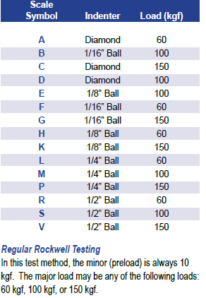
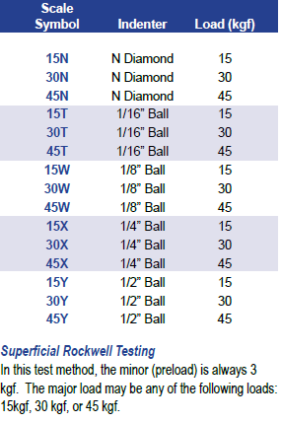
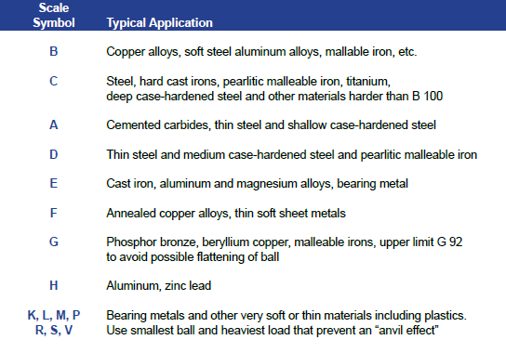
What is Rockwell Hardness Testing?
Invented by Stanley P. Rockwell, it enabled users to perform an accurate hardness test on a variety of sized parts in just a few seconds.
Most common form of hardness testing.
The Rockwell method measures the permanent depth of indentation produced by a force/load on an indenter.
Two Different Types: Regular Rockwell and Superficial Rockwell testing.
Uses many different scales, depending on material being tested.

Slide 4
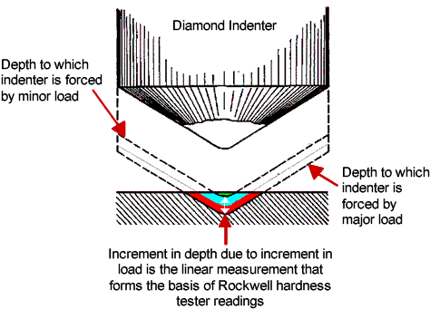
How Does Rockwell Testing Work?
1. The indenter moves down into position on the part
surface.
2. A minor load is applied and a zero reference position is
established.
3. The major load is applied for a specified time period
(dwell time) beyond zero.
4. The major load is released leaving the minor load
applied.
Works Cited:
http://www.evatestlab.com
http://www.Hardnesstesters.com/Applications/Rockwell-Hardness-Testing.aspx
http://www.instron.us/wa/applications/test_types/hardness/rockwell.aspx
http://www.picstopin.com
http://www.wilson-hardness.com

Slide 5
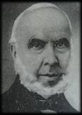
Lab 2: Crystallography & Miller Indices
Overview:
In this lab, the class split into two groups. One group went to the lab and broke crystal wafers. The second group, which included Cody, Shane, and myself, researched Miller Indices.
Definition of Miller Indices:
Miller indices - group of three numbers that indicates the orientation of a plane or set of parallel planes of atoms in a crystal.
Miller Indices - (a method of describing planes and directions within a crystal)
A better Sense of things:
-If each atom in the crystal is represented by a point and these points are connected by lines, the resulting lattice may be divided into a number of identical blocks, or unit cells.
-The intersecting edges of one of the unit cells defines a set of crystallographic axes, and the Miller indices are determined by the intersection of the plane with these axes.
-The reciprocals of these intercepts are computed, and fractions are cleared to give the three Miller indices (hkl).
Devised by British mineralogist and crystallographer William Hallowes Miller, in 1839, has the advantage of eliminating all fractions from the notation for a plane.

Slide 6
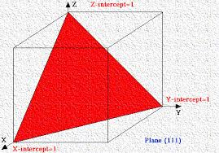
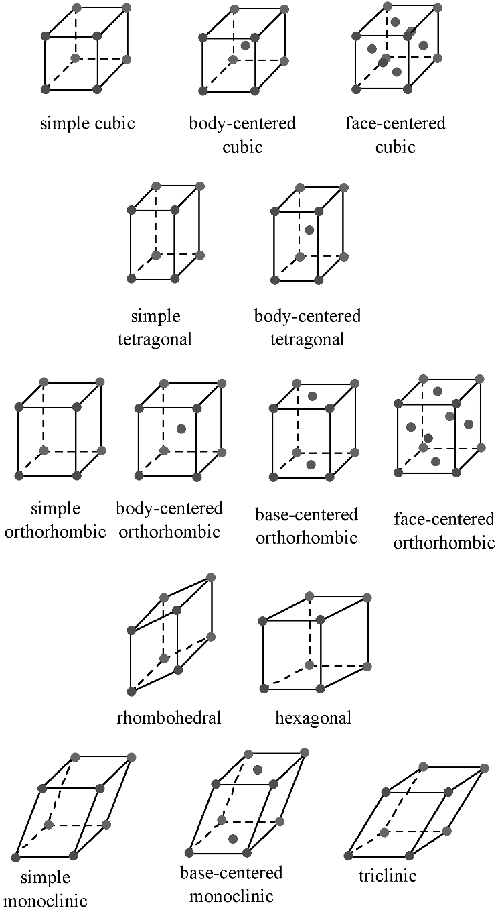
Conclusion:
If a Miller index is zero, the plane is parallel to that axis.
The smaller a Miller index, the more nearly parallel the plane is to the axis.
The larger a Miller index, the more nearly perpendicular a plane is to that axis.
Multiplying or dividing a Miller index by a constant has no effect on the orientation of the plane.
Miller indices are almost always small.
Works Cited:
http://www.britannica.com/EBchecked/topic/382843/Miller-indices
chemistry.bd.psu.edu
http://cnx.org/content/m16927/latest/

Slide 7
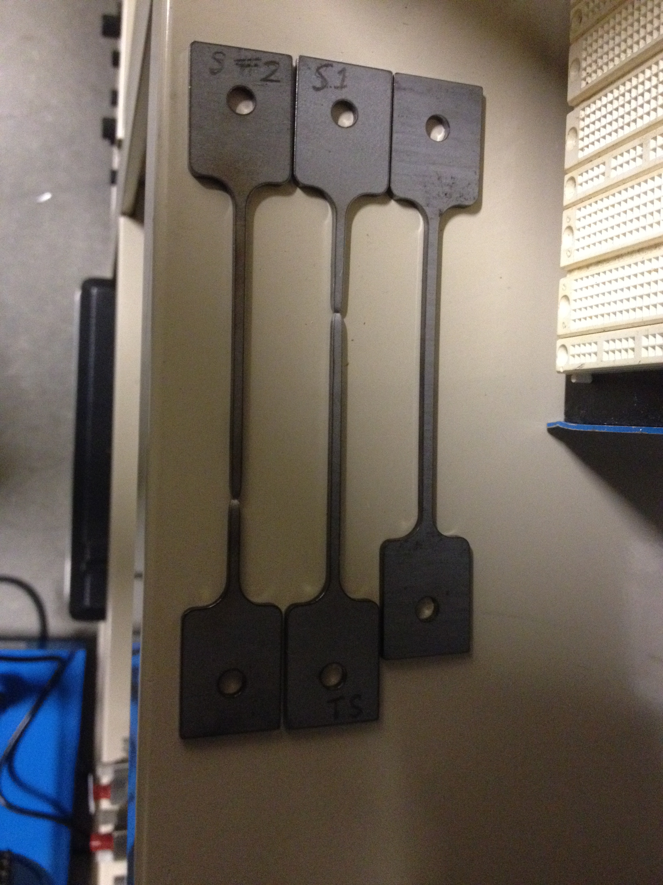
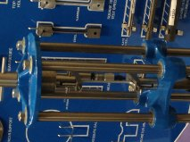
Lab 3: T9014 Steel Tensile Testing
Overview:
In this lab, William, John, Michael, and myself formed a team tasked with tensile testing 2 steel samples. We then put the data into Microsoft Excel Spreadsheets to show stress and strain.
Sample One
Sample One

Slide 8
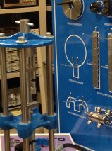
**We were able to calculate the stresses of both samples by converting the voltage 2 data using the formulas below. The strain was calculated by using the Modulus of elasticity of steel.**
Sample two
Sample two
Two samples compared to unused sample.

Slide 9
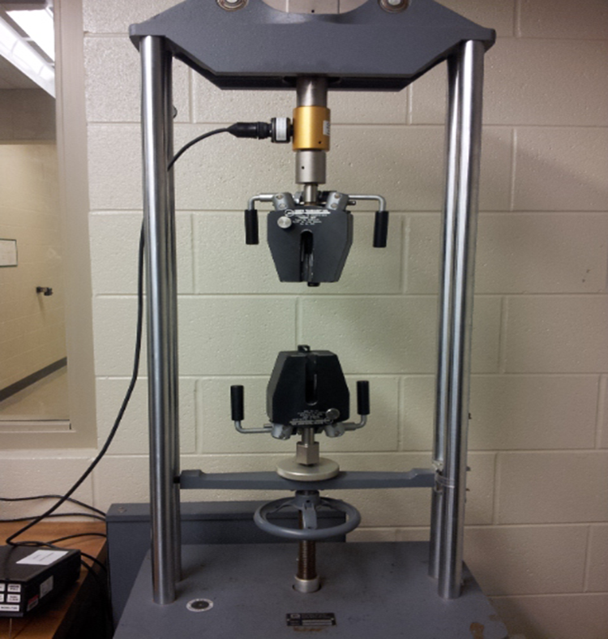
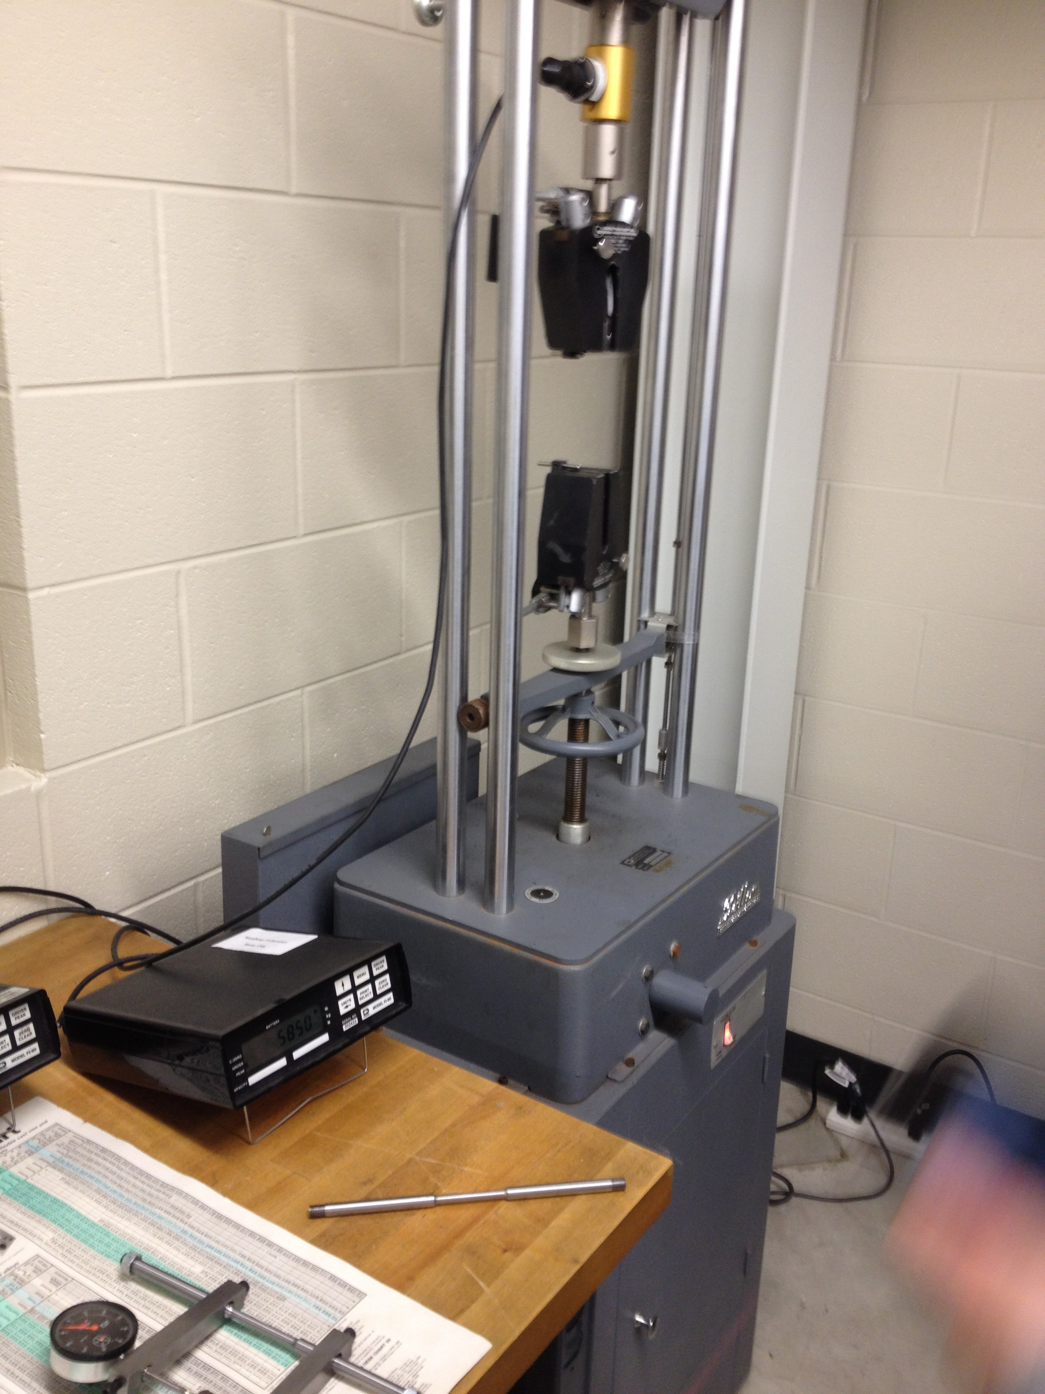
Lab 4: Tensile Testing Steel (TC1548)
Overview:
In this lab, we worked as a class to test the tensile strength of two samples of steel. One person increased the length of sample (using machine) in .002 inch increments, while another person called out the Force being applied. Using that data, combined with pre and post measurements of diameter and marked length, we could come up with stress/strain curves.
Stress equation:
σ= P/A
Strain equation:
ϵ= (l-lo)/lo
Measures Force

Slide 10
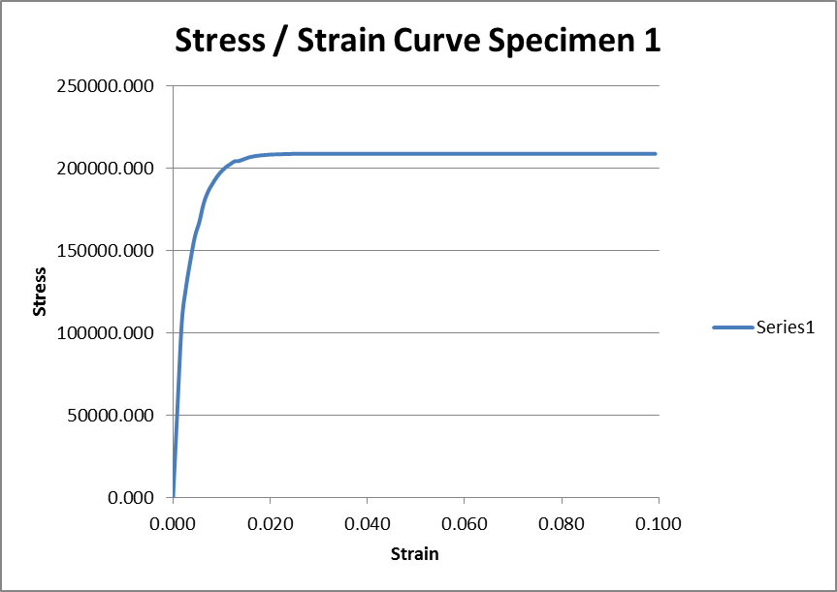
Data: Specimen 1
*The curve never drops off because the force reading machine was set to “peak”, so once it reached its peak, it never recorded anything lower than that.*

Slide 11
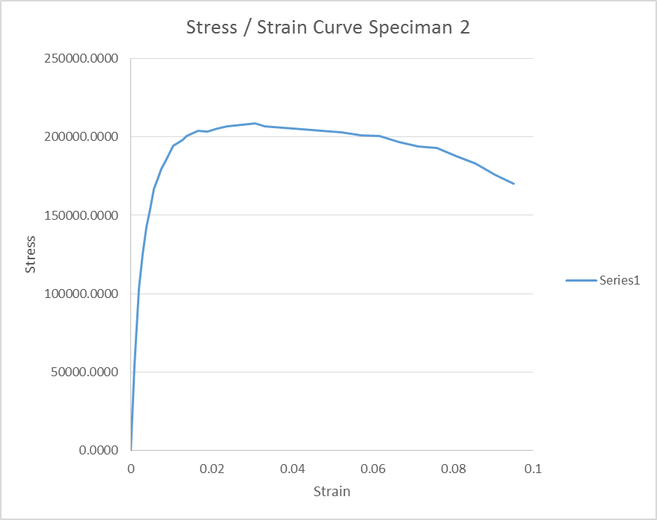
Data: Specimen 2
*As you can see in this curve, there is a drop off in the plastic deformation stage as there should be.*

Slide 12
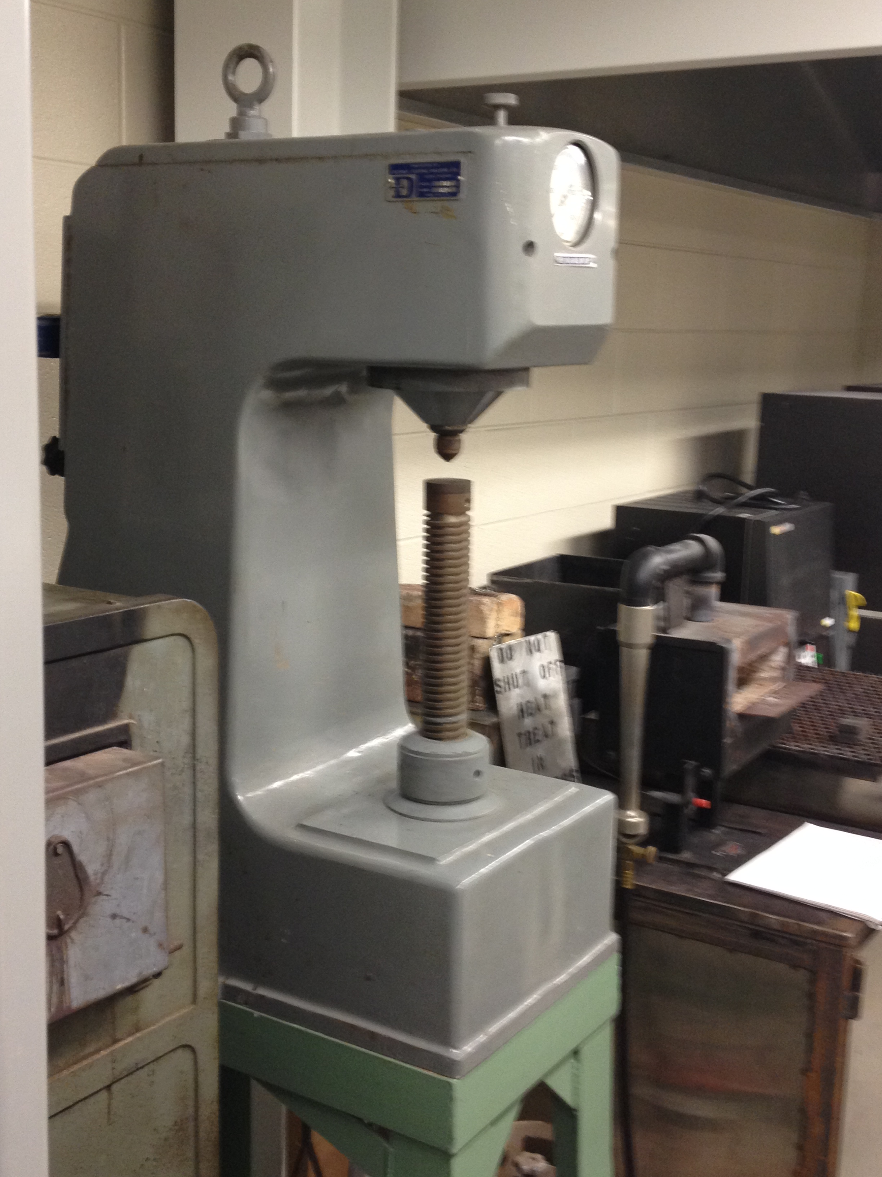
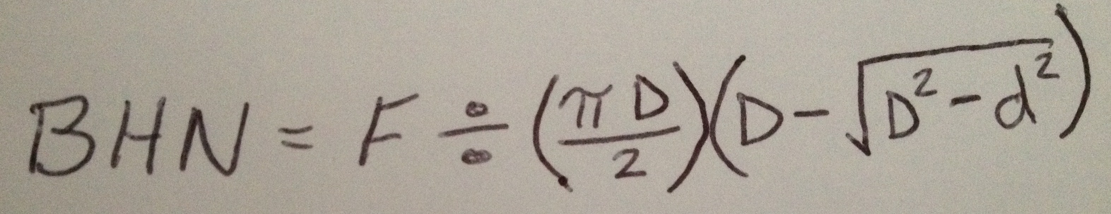
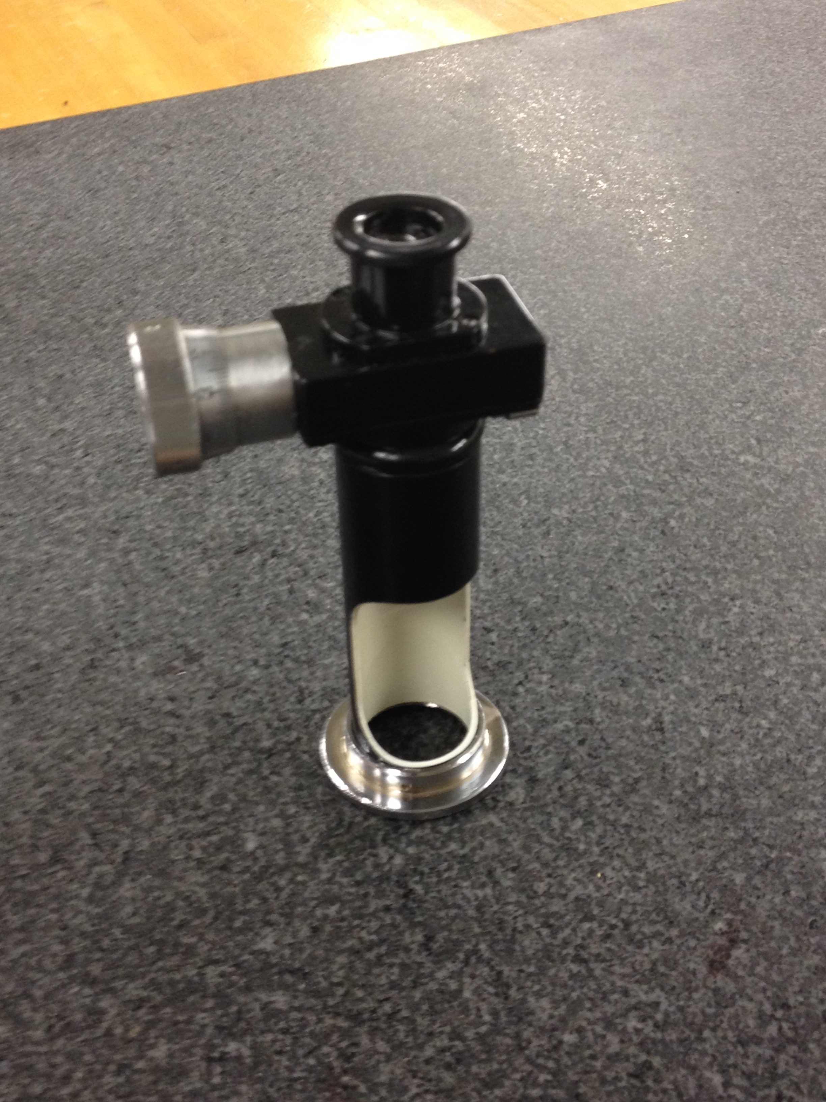
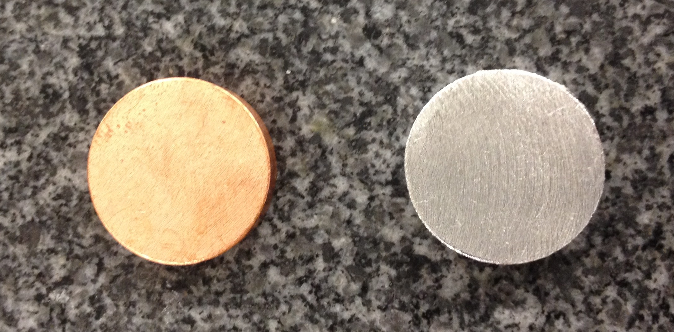
Lab 5: Brinnell & Rockwell Hardness Testing
Overview:
In this lab we worked as a group to use the Brinnell Hardness tester and the Rockwell Hardness tester to test two samples of aluminum and two samples of copper. The Brinnell test required us to use a microscope to measure the Diameter and then use this formula to get a score: .
Copper
Aluminum
Microscope
Brinnell Testing Machine

Slide 13
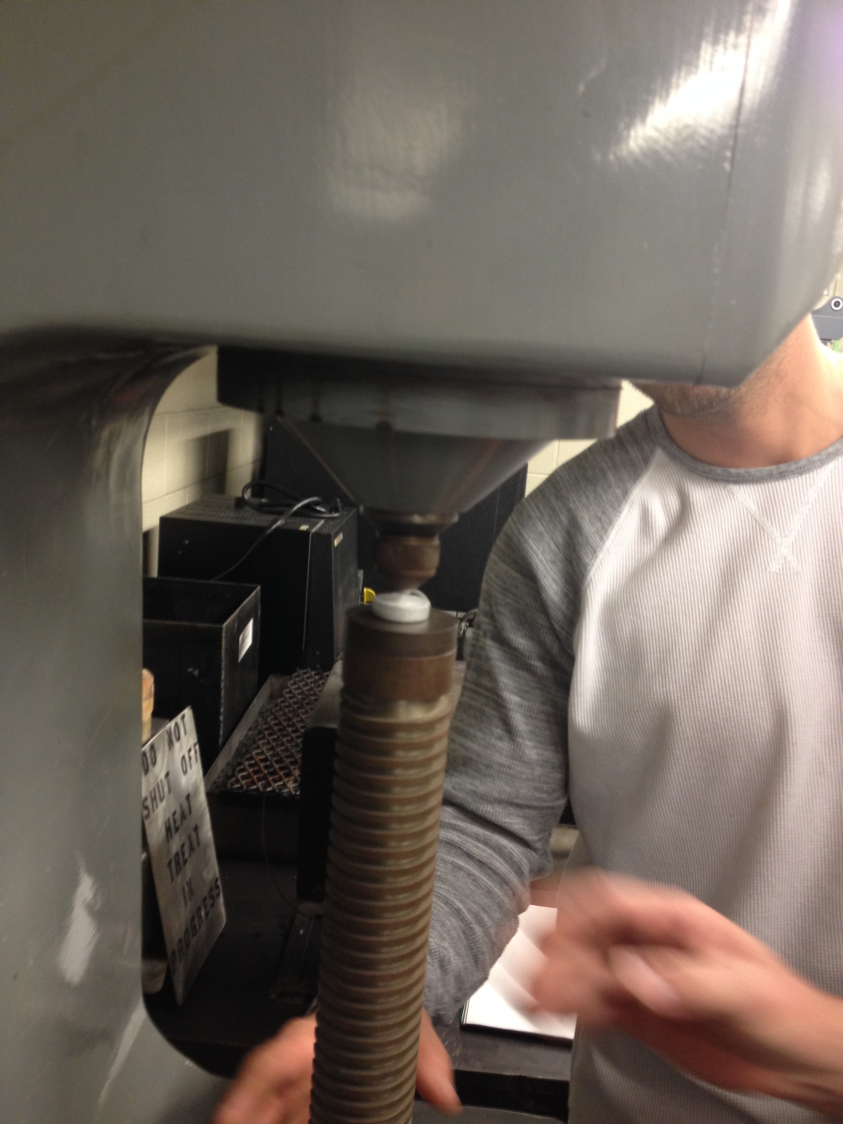
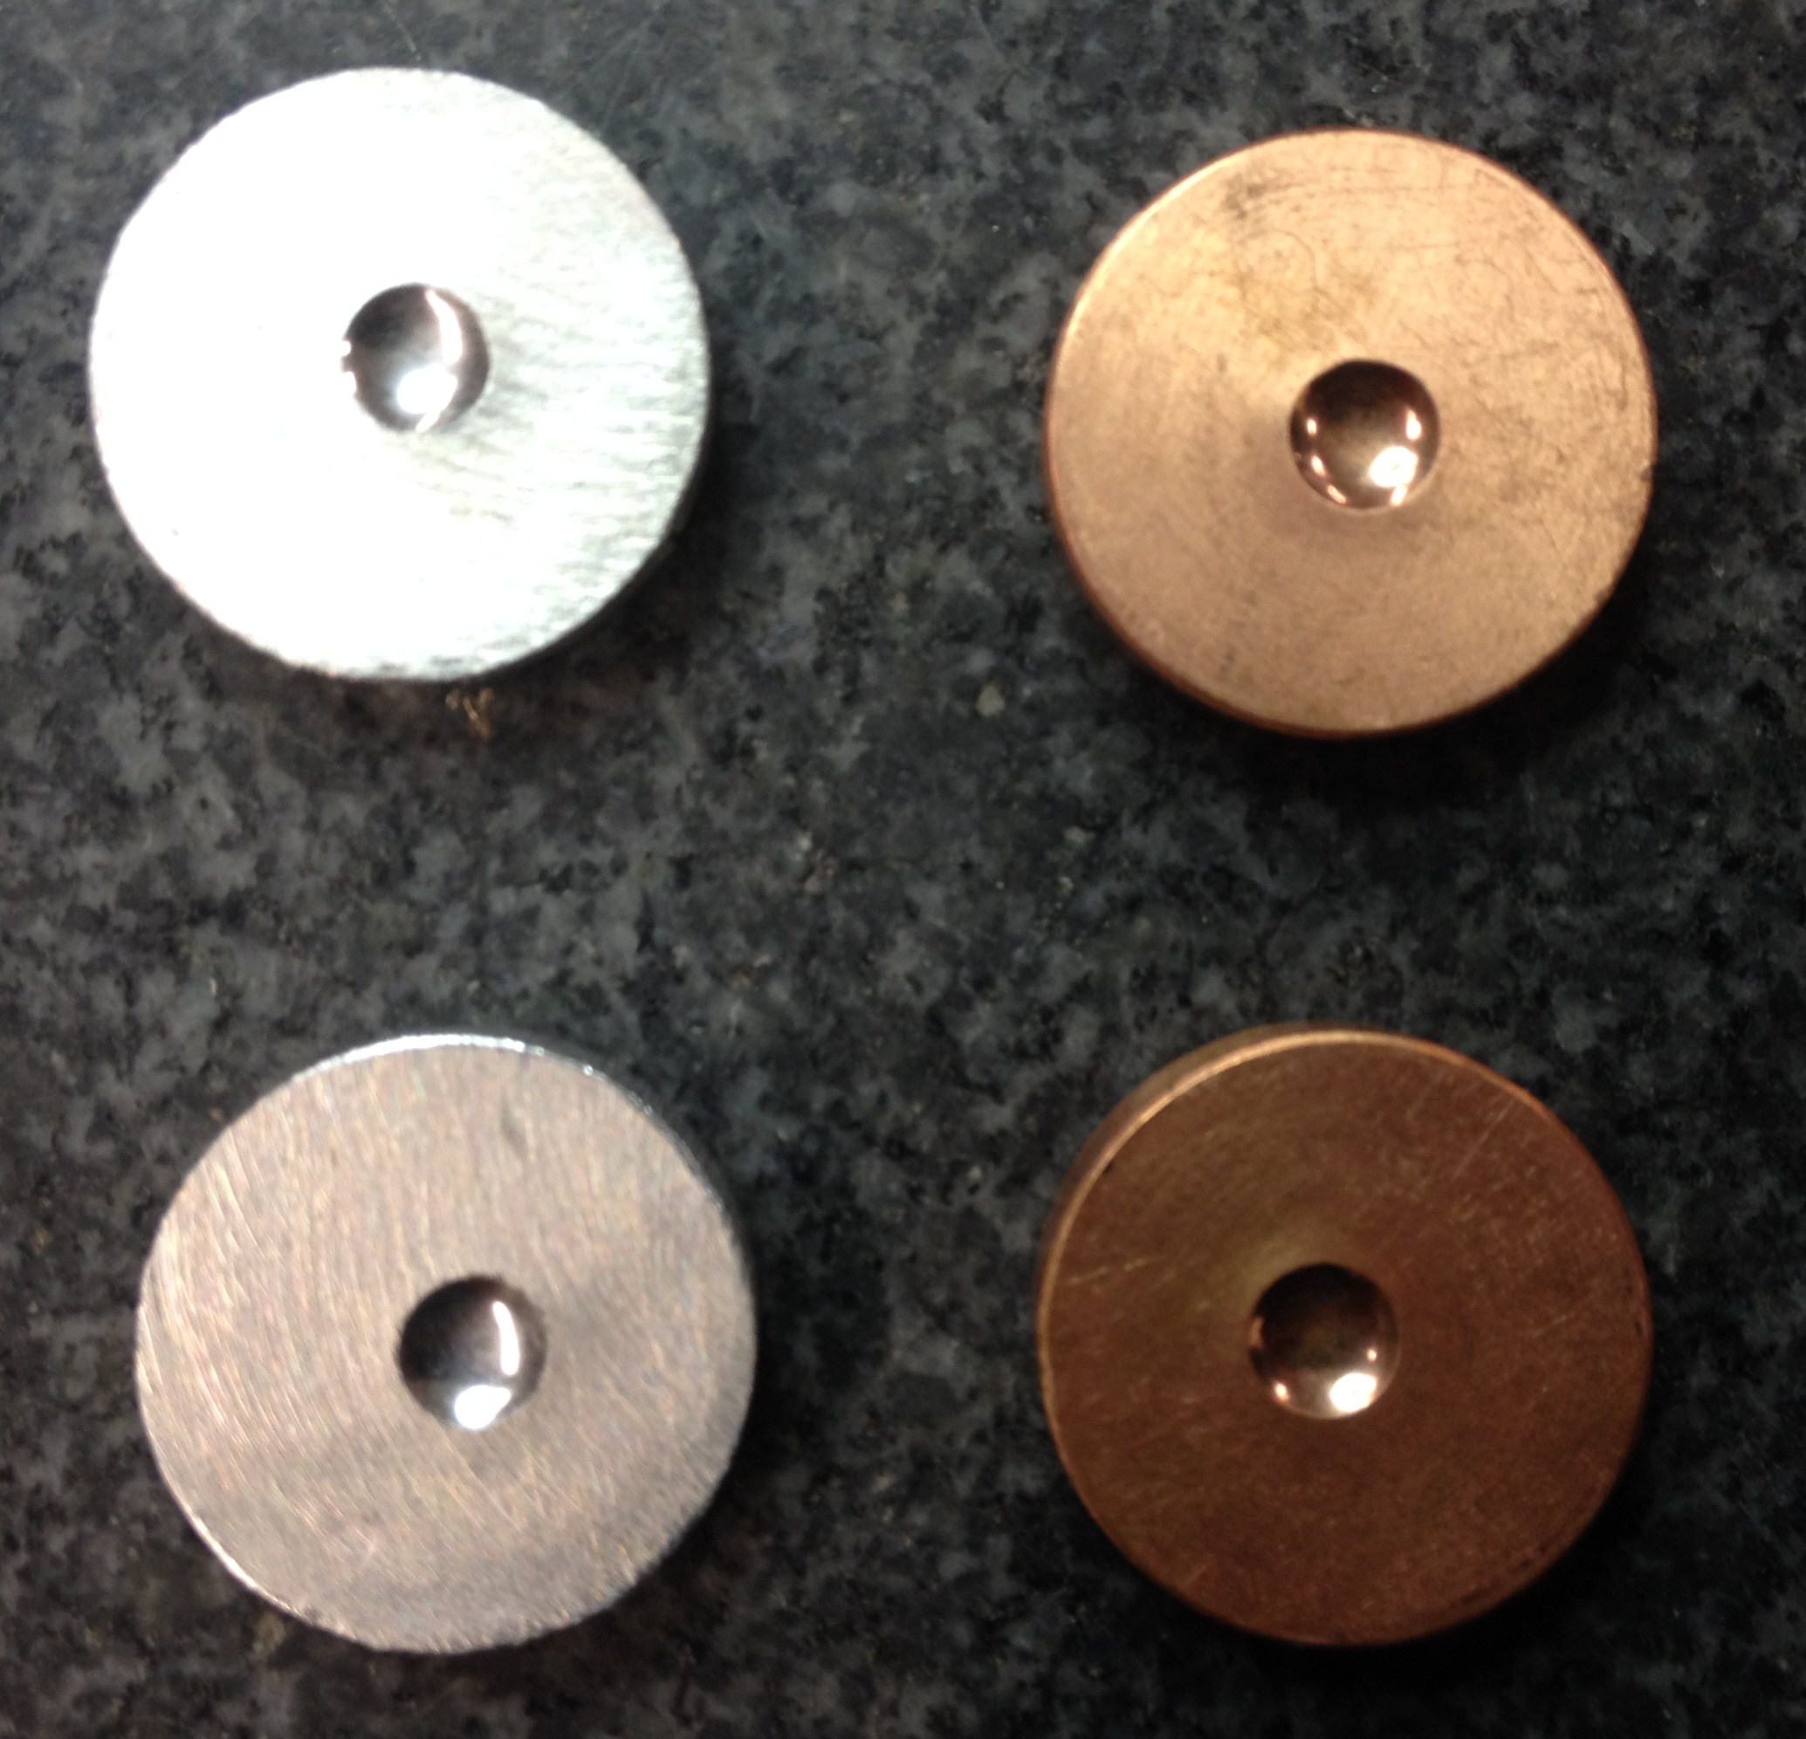
Brinnell Pre-test Specifications:
Rockwell Pre-test Specifications:
Brinnell Scores after Formula:
Rockwell Scores:

Slide 14
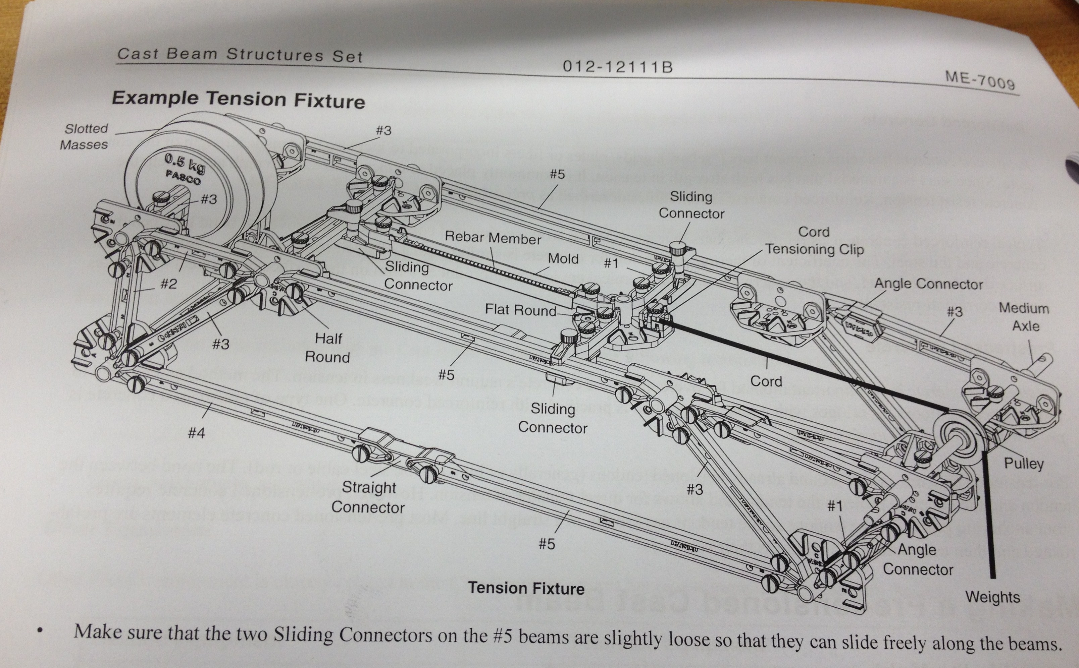
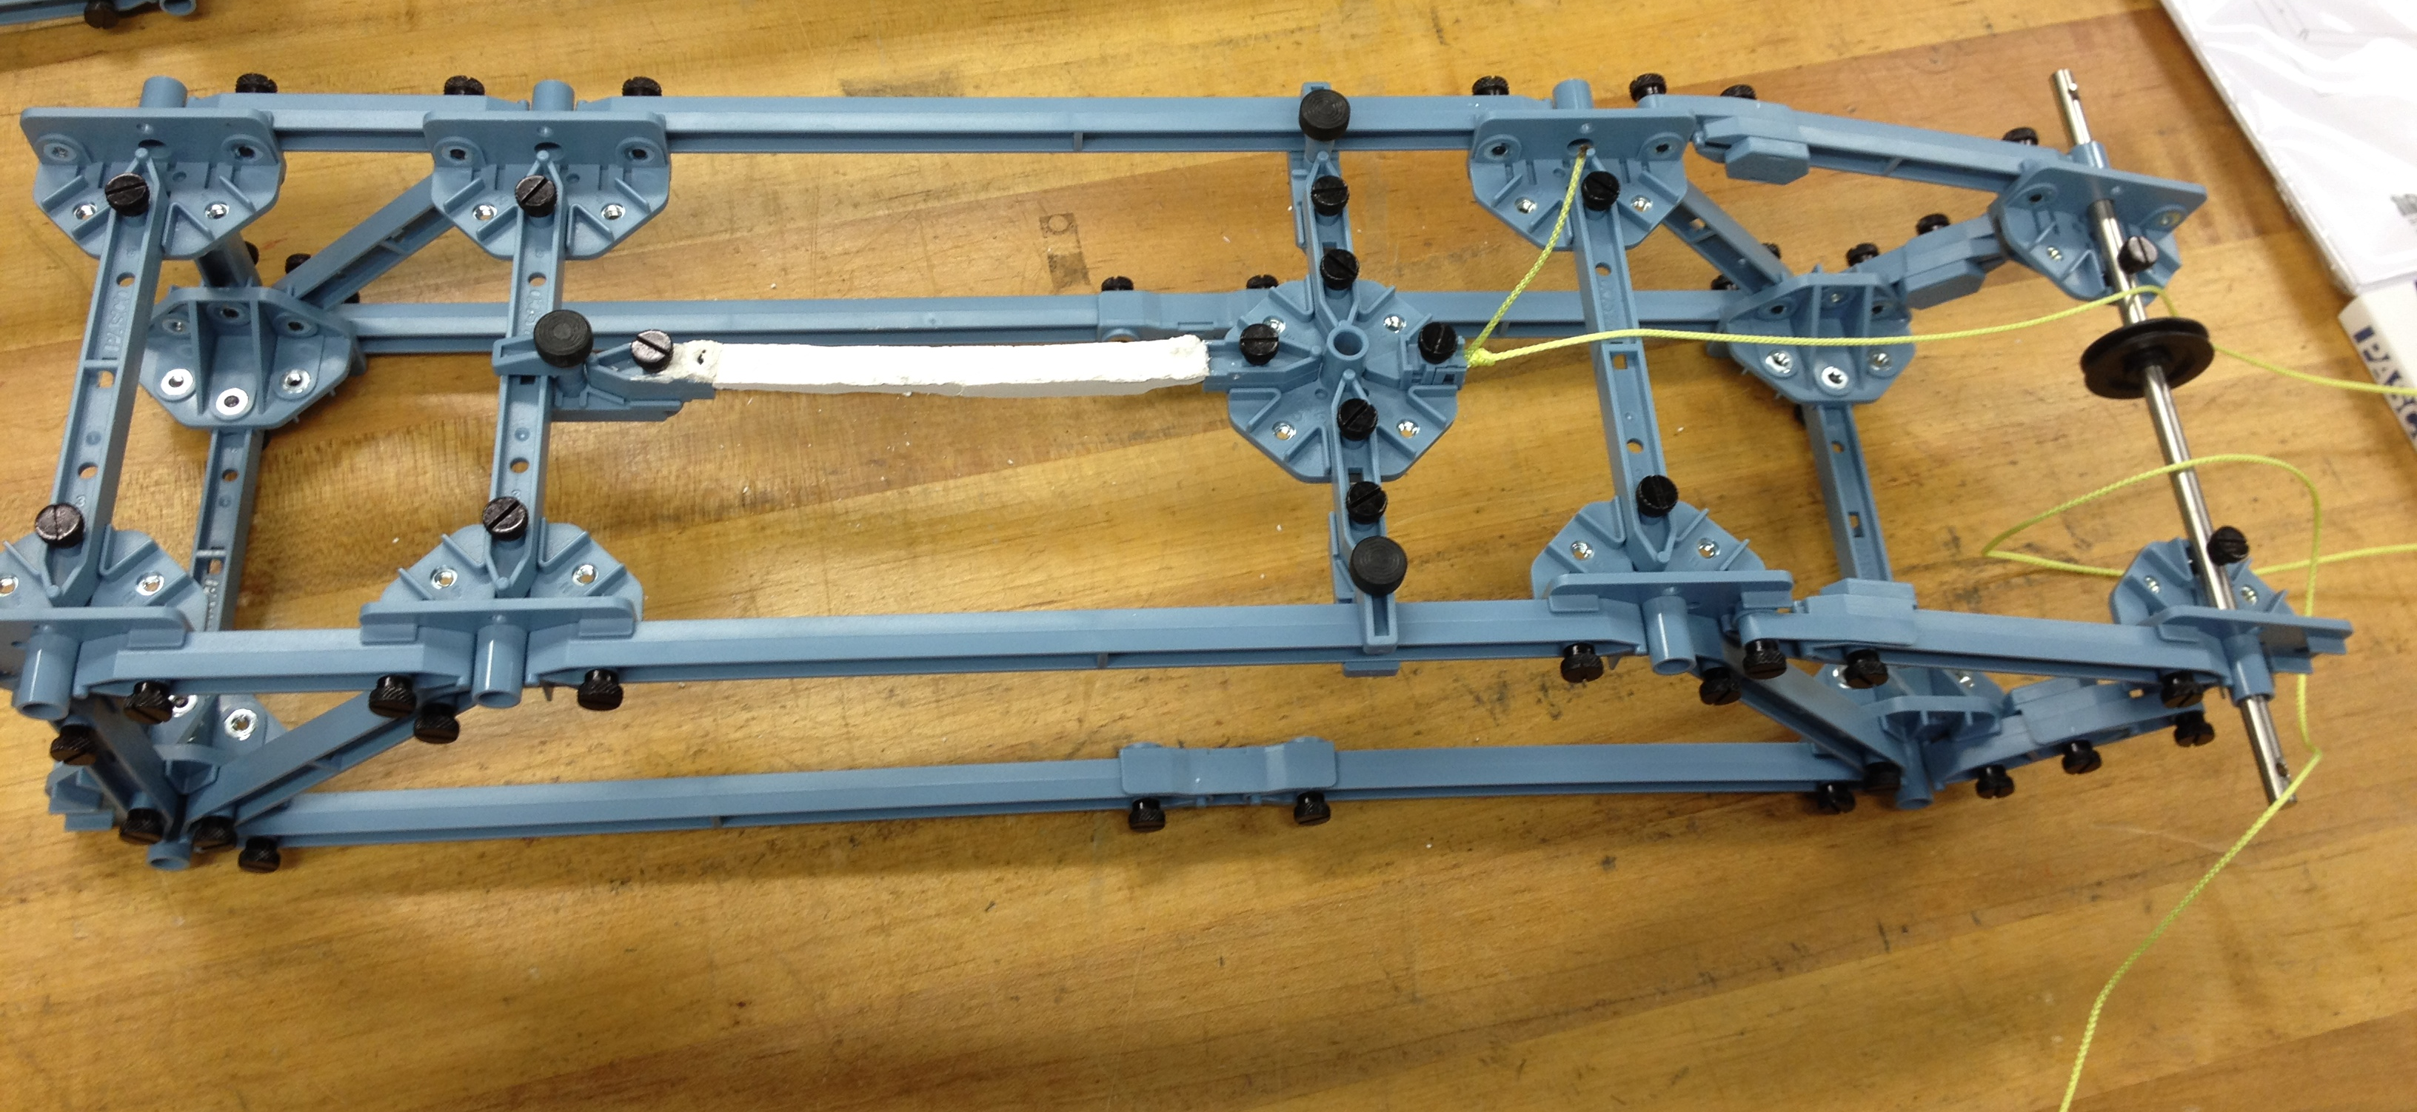
Lab 6: Pasco Strength Testing
Overview:
In this lab I worked with Cody and William. We used an instruction guide and built a Pasco Strength Testing machine. This machine was supposed to test the strength of samples we built out of sand and Plaster of Paris.

Slide 15
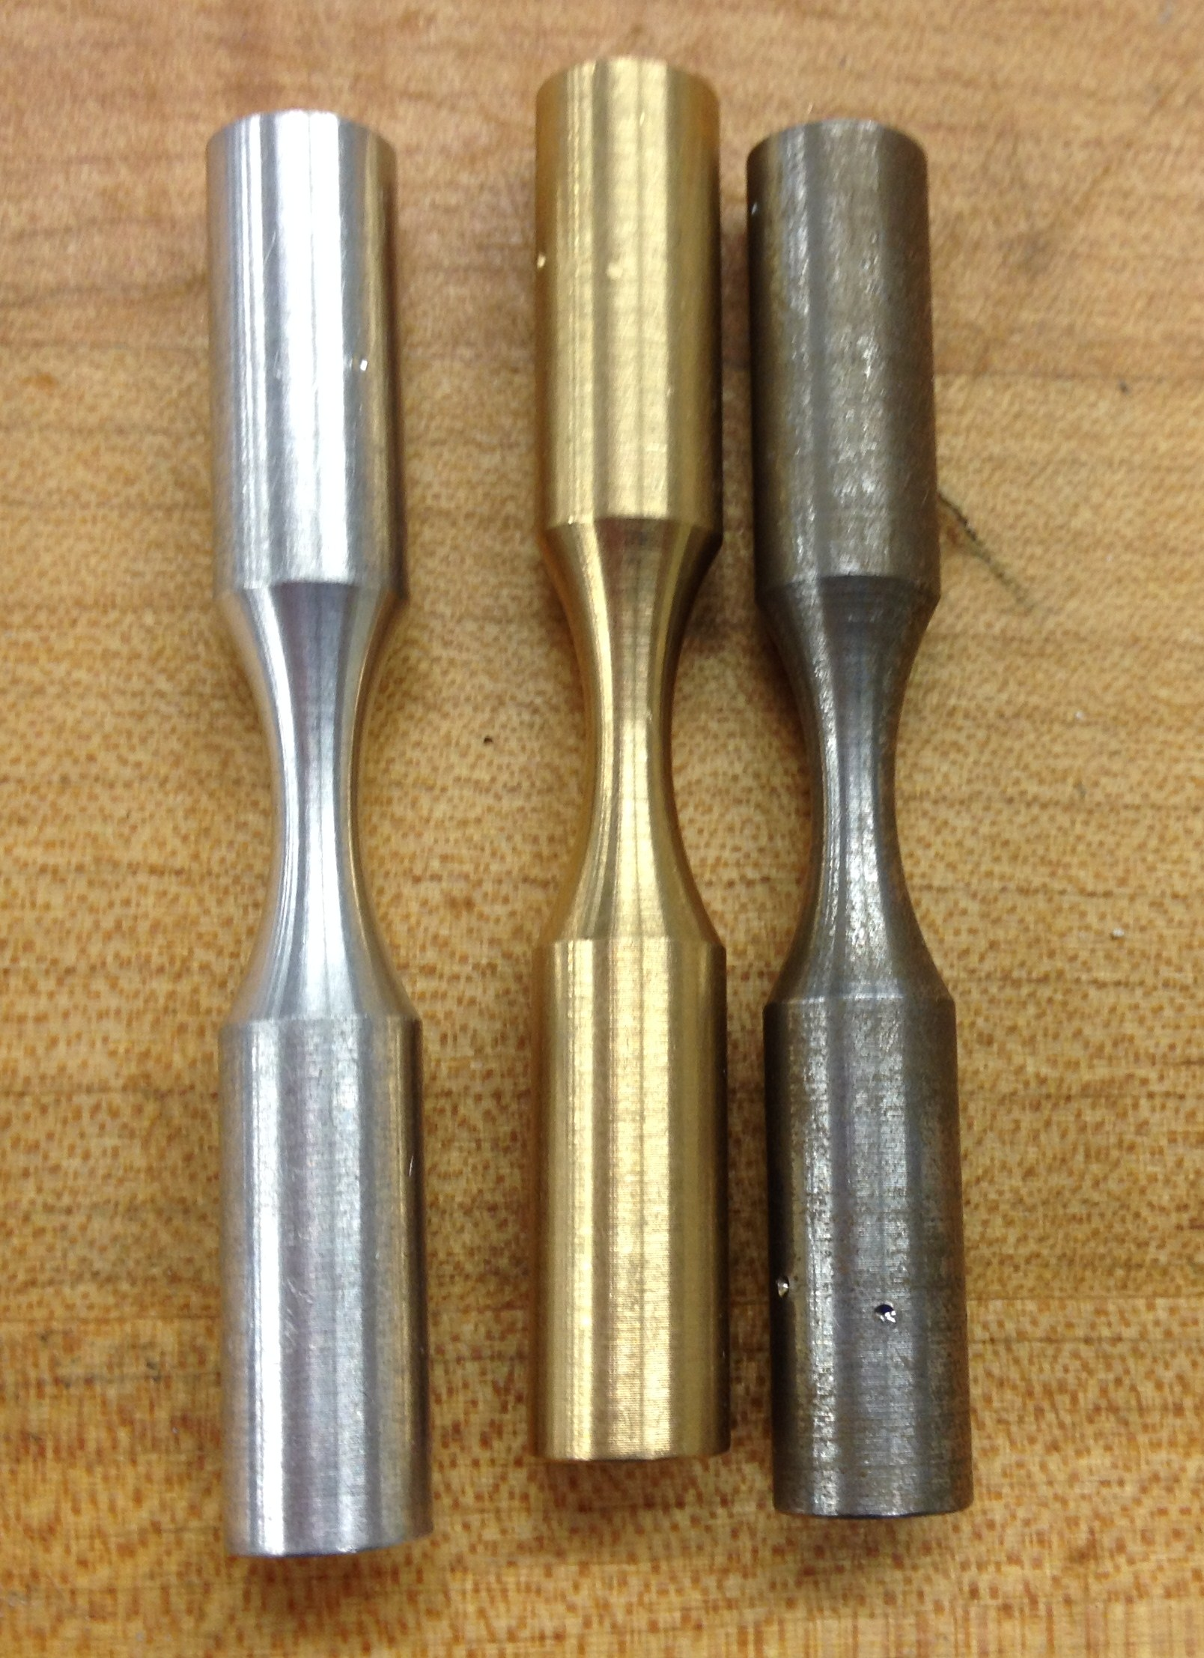
Lab 7: Rockwell Hardness Testing
Overview:
In this lab we worked as a group and measured the hardness of three cylindrical samples, including Steel, Aluminum, and Brass. We also measured the hardness of flat Steel and flat Aluminum to compare.

Slide 16
Pre-test Specifications (round Samples)
Data Test 1:
Data Test 2:
Data Test 3:
We knew this data had to be wrong because it didn’t comply with any known data about these materials. We realized we were not using the correct set point when measuring.
We were pretty sure this data was wrong as well, but because of using wrong scale, not inaccurate measuring.
We were pretty sure this data was measured correctly and accurately while using correct scale.

Slide 17
Pre-test Specifications (flat Samples)
Data Test 1:
Data Test 2:
These numbers seemed to fit into the scale nicely.
Aluminum was off the charts so we re-measured it on H Scale where it scored 95.5 Rh on a 60Kg major load.

Slide 18
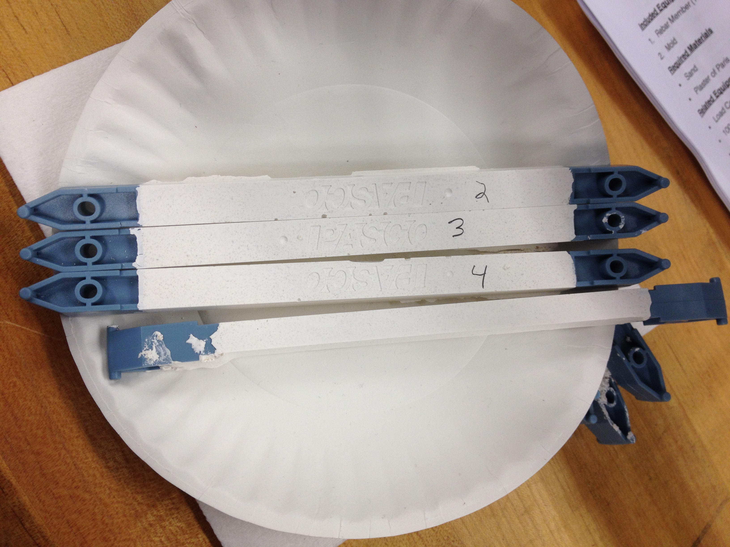
Lab 8: Building Pasco Samples
Overview:
In this lab we built the samples that we were going to test on our Pasco machine we built in lab 6.
Process:
We were split into two teams to make two different mixtures of sand, Plaster of Paris and water. The other group mixed equal parts of sand (6Tbsps) and Plaster of Paris (6Tbsps) with 12 Tbsps. of water. Our group of William, Mike, and myself used a mixture of 6 Tbsps. of Plaster of Paris with 3 Tbsps. of sand and only 10 Tbsps. of water. We then put mixture into the molds and let dry till next class.
Results:
When we went to test the samples, we couldn’t break them due to an error in building the molds.

